Slide 1
Crime Data in Los Angeles

Slide 2

Analysis
By Jai Dave
Report as part of The Springboard Data Science Career Track
You can reach me at jbdave112@gmail.com

Slide 3

Target Audience
POLICE OFFICERS CAN USE THIS DATA TO BE MORE EFFICIENT ON PATROLS
PUBLIC POLICY MAKERS CAN USE THIS DATA TO CREATE LEGISLATION THAT WILL HELP ALLEVIATE CRIME
POLICE CAPTAINS CAN USE THIS DATA TO MAKE DEPARTMENTS MORE EFFECTIVE

Slide 4
Problems and Solutions
Determining where crimes are occurring to aid communities that need it the most
My analysis will consist of three main topics: WHERE crimes are occurring, WHEN crimes are occurring, and WHO are most victimized by crimes
Determining when crimes are occurring to make serving communities more efficient
Determining who are the victims of crime to help populations who are the most vulnerable

Slide 5
Executive Summary
The area with the highest crime rate is 77th St.
Assault with a deadly weapon makes up a larger proportion of the area’s crimes with firearms the primary weapon used
Creating and promoting campaigns like the anonymous gun buyback in this area may help curb assaults with use of a firearm
The time with the highest crime rate is Friday Afternoon
Friday afternoon has a higher number of thefts than the sample as a whole
This could be because individuals have debts due at the end of the week and they turn to crime out of desperation
Creating policies to improve income distribution could reduce these types of crime
The Latino, White, and Black populations make up the most victims
The distribution of age and victims appear to follow the demography of Los Angeles with the exception of Black Males who appear to be under represented
Black males may be reluctant to report crimes to authorities
Promoting community outreach programs may help increase trust with communities

Slide 6
Methodology and Objectives
Purpose: Find trends in the data that can be acted upon to reduce crime
Methodology: Explore the data visually and test if differences are significant
Tools: Use Python to get data from the LA city’s website
Dataset: The dataset reflects incidents of crime dating back from 2010 provided from the Los Angeles Police Department, where each row is a crime incident

Slide 7
233,090
The Number of Crimes Reported in Los Angeles during the year 2017

Slide 8
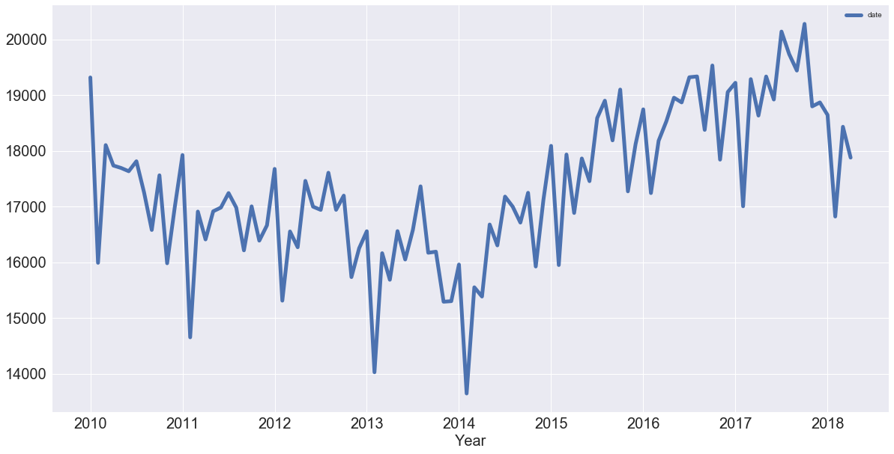
Crime Over Time

Slide 9
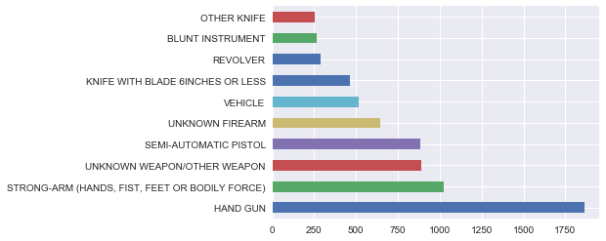
Where are Crimes Occuring?
My analysis found that the 77th St. Area had the highest crime rate
Approximate Population: 175,000
Area: 11.9 Square Miles
77th St. has a significantly higher number of “Assaults with a Deadly Weapon” than the sample as a whole
What weapons are being used for assaults?
From the illustration we can see that handguns are by far the lead weapon used for assaults

Slide 10
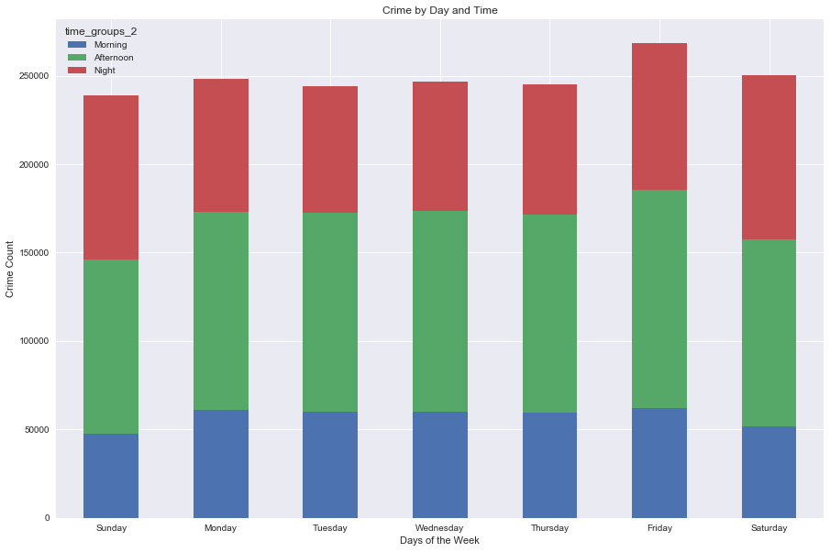
When are Crimes Occurring?
Friday afternoons show a spike in crime rate
On closer inspection Thefts appear to be come common during this time

Slide 11
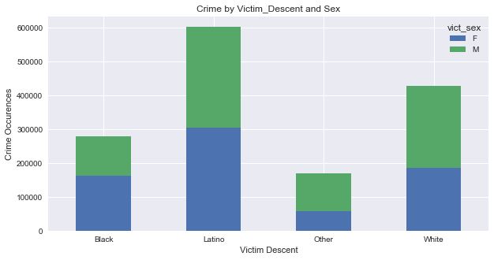
Who are the Victims of Crimes?
Victims are more likely to be Hispanic, White, or Black
Among black victims females outnumber males
This could possibly be because Black Victims are less likely to report crimes

Slide 12

THANKS!
Any questions?
You can find me at
jbdave112@gmail.com

Slide 13
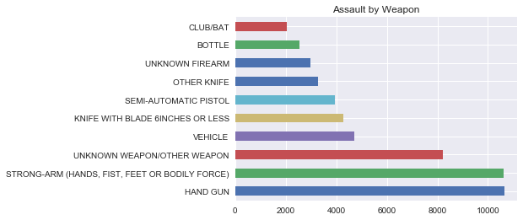
Appendix A: Weapons used for Assault

Slide 14
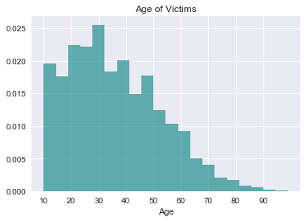
Appendix B: Distribution of the Age of Victims

